Slide 1

CSAT Analytics Project (PRDA – 02)
Customer Satisfaction & Call Center Report
Presented by: Pooja Gupta

Slide 2
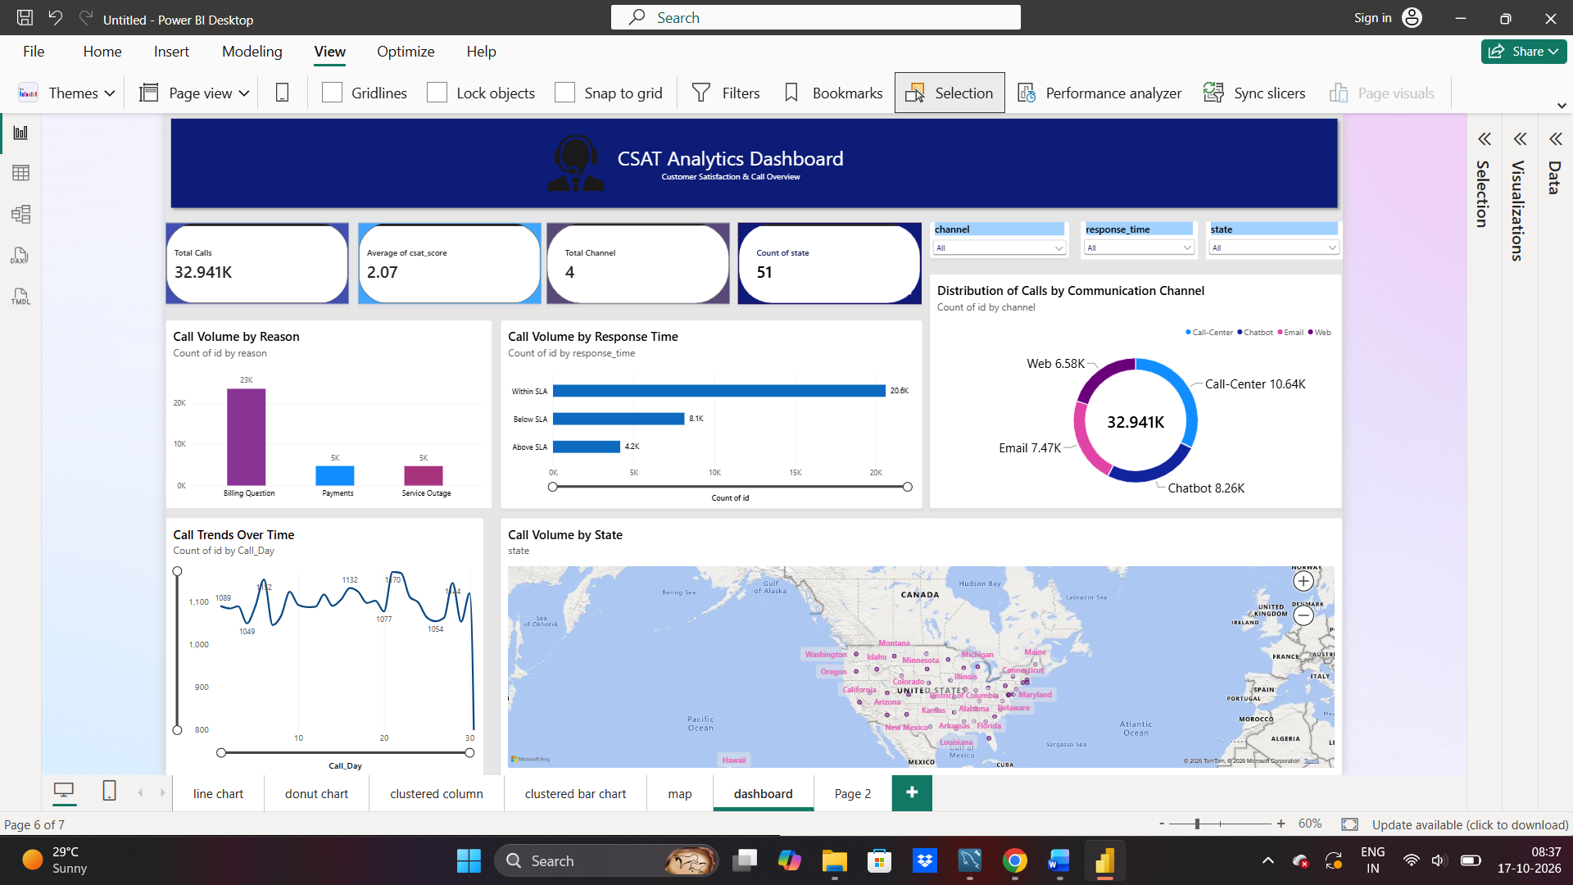

Slide 3
Key Insights & Findings
Primary Call Driver: Billing Questions account for ~70% of total volume (23K+ calls).
SLA Compliance: 20.6K calls resolved Within SLA, while 4.2K calls breached threshold (Above SLA).
Channel Distribution: Call Center handles maximum volume (10.64K calls), followed by Chatbot and Email.
Geographic Distribution: Inquiries spread across 51 US states, led by California.

Slide 4

Recommendations & Conclusion
Automate
Automate Billing FAQs: Implement self-service features in Chatbot to handle simple billing queries and reduce agent workload.
Allocate
SLA Improvement: Allocate additional resources during peak call hours to minimize SLA breaches.
Channel
Channel Optimization: Encourage customers toward Chatbot and Web channels for faster issue resolution.

